Slide 1


Slide 2


TODAY’S AGENDA
Introduction To Jquery Selectors
Types Of Selectors
Syntaxes And Uses
Examples

Slide 3
INTRODUCTION TO SELECTORS
A very common task in jQuery is to read and modify the content of the page and to do this, we need to find the element(s) that we wish to change.
This is where selector support in jQuery will help us out.

Slide 4
INTRODUCTION TO SELECTORS
A selector in jQuery is a way to find elements of our page.
Selectors can select elements based on their ID, classes, types, attributes, values of attributes and much more.

Slide 5
GENERAL SYNTAX
Since selectors are the most common part of jQuery they come in several forms.
A selector takes a query as an argument , locates the element and returns a jQuery object.

Slide 6
GENERAL SYNTAX
Therefore, selecting a set of elements is as simple as this: $(<query here>)
With the jQuery object returned, we can then start using and altering the element.

Slide 7
THE id SELECTOR
A very common selector type is the ID based.
It uses the ID attribute of a HTML element to locate the desired element.
Syntax:
$(“#idvalue”)
Example:
$(“#div1”)

Slide 8
EXAMPLE
Jquery Code:
<script type="text/javascript" >
$(document).ready(function()
{
$("#p1").css("font-weight","bold");
});
</script>
HTML Code:
<p id="p1">
This is a para altered with jQuery.
</p>

Slide 9
THE class SELECTOR
Elements with a specific class can be matched by writing a . character followed by the name of the class.
Syntax:
$(“.classvalue”)
Example:
$(“.highlight”)

Slide 10
EXAMPLE
Jquery Code:
<script type="text/javascript" >
$(document).ready(function()
{
$(“.highlight").css(“color",“coral");
});
</script>
HTML Code:
<ul >
<li class="highlight">JavaScript</li>
<li>Java</li>
<li class="highlight">JQuery</li>
</ul>

Slide 11
THE element SELECTOR
Elements can also be selected on the basis of their tag names. For example, all anchors can be selected as :
$(“a”)
Similarly all paragraphs can be selected as:
$(“p”)
We also can combine selectors as:
$(“li.highlight”)
This selects only listitems with class as “highlight”

Slide 12
THE attribute SELECTOR
Till now we have selected from their class or their ID attributes.
But with jQuery, we can actually find elements based on any kind of attribute.
The syntax for this selector is a set of square brackets with the name of the desired attribute inside it.
Syntax:
$(“element[attribute=value]”)

Slide 13
EXAMPLES
Find the anchor tag whose href is equal to http://www.youtube.com
$("a[href='http://www.youtube.com']").css("font-size","30px");
Find input elements whose name attribute starts with a specific string using the ^= operator:
$("input[name^='txt']").css("color", "blue");

Slide 14
EXAMPLES
Find input elements whose name attribute ends with a specific string using the $= operator:
$("input[name$='txt']").css("color", "red");
Find input elements whose name attribute contains a specific string using the *= operator:
$("input[name*='txt']").css("color", "blue");

Slide 15
PARENT CHILD SELECTORS
jQuery also allows us to select elements based on their parent elements.
There are two variations:
One which will only match elements which are a direct child to the parent.
One which will match all the way down through the hierarchy, eg. A child of a child of a parent elements.

Slide 16
SYNTAX FOR DIRECT CHILD
The syntax for finding children which are direct descendants of an element :
$(“div>a”);
This selector will find all links which are the direct child of a div elements.

Slide 17
SYNTAX FOR ANY CHILD
Replacing the greater-than symbol with a simple space will change this to match all links within a div elements, no matter if they are directly related or not:
$(“div a”);

Slide 18
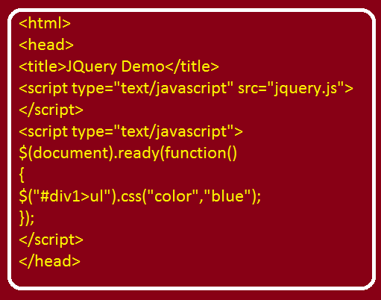
EXAMPLE(>)

Slide 19
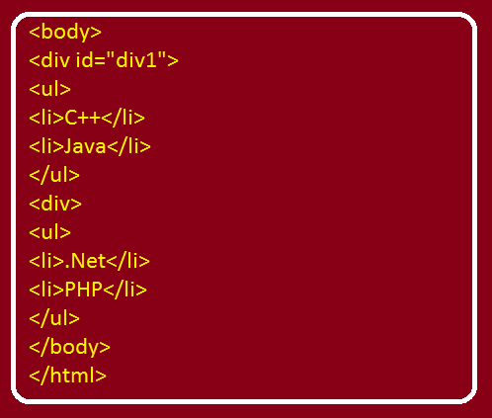
EXAMPLE(Direct Child)

Slide 20
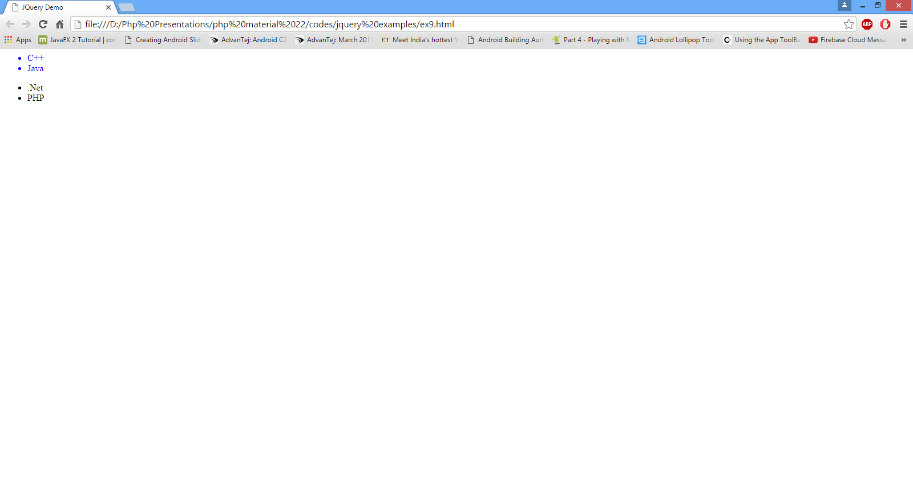
OUTPUT(Direct Child)

Slide 21
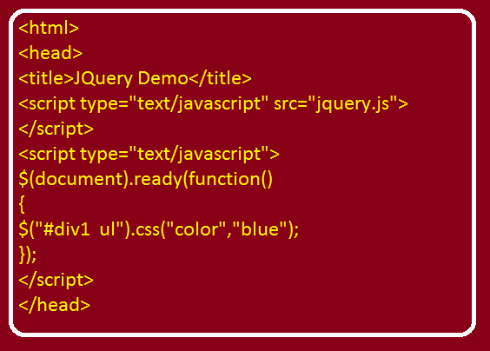
EXAMPLE(Any Child)

Slide 22
EXAMPLE(Any Child)

Slide 23
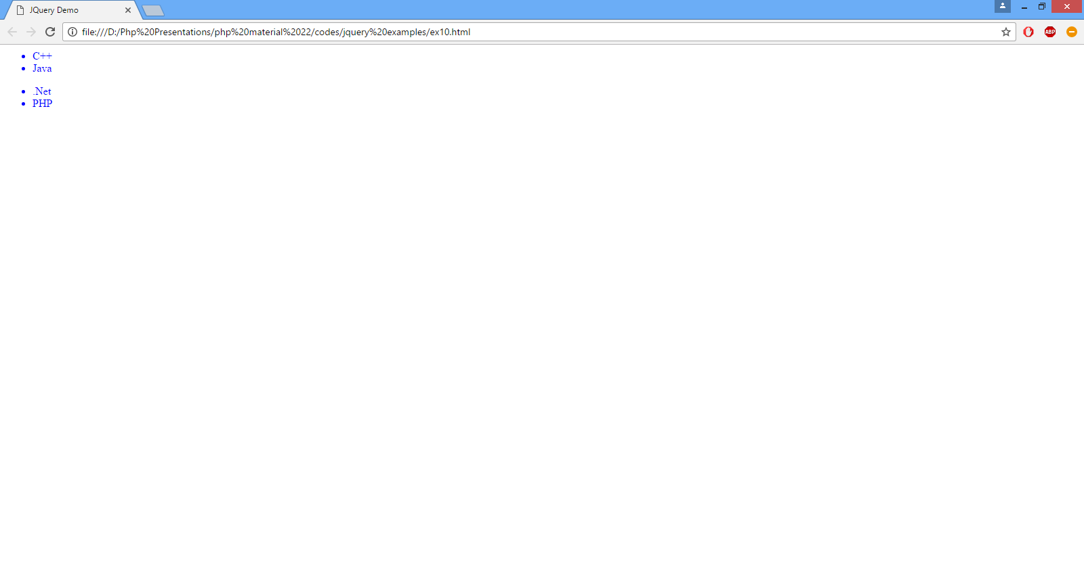
OUTPUT(Any Child)

